Slide 1
Introduction to Distributed Version Control

Slide 2
Version Control
Version control
Tracking files over time
Before version control
File renaming
Document.txt
Document.old.txt
Document_20140301.txt
✓ Directories
\Documents_March_2014
✓
Zip files
Documents_March.zip
✓ Nothing at all

Slide 3
Properties of a Version Control System (VCS)
Backup and Restore.
Synchronization.
Short-term undo.
Long-term undo. Sometimes we mess up bad. Suppose you made a change a year ago, and it had a bug. Jump back to the old version, and see what change was made that day.
Track Changes.
Track Ownership.
Sandboxing, or insurance against yourself.
Branching and merging. A larger sandbox.

Slide 4
Version Control Concepts
Basic Setup
Repository (repo): The database storing the files.
Server: The computer storing the repo.
Client: The computer connecting to the repo.
Working Set/Working Copy: Your local directory of files, where you make changes.
Trunk/Main: The primary location for code in the repo. Think of code as a family tree — the trunk is the main line.

Slide 5
Version Control Concepts
Basic Actions
Add: Put a file into the repo for the first time, i.e. begin tracking it with Version Control.
Revision: What version a file is on (v1, v2, v3, etc.).
Head: The latest revision in the repo.
Check out: Download a file from the repo.
Check in: Upload a file to the repository (if it has changed). The file gets a new revision number, and people can “check out” the latest one.
Checkin Message: A short message describing what was changed.
Changelog/History: A list of changes made to a file since it was created.
Update/Sync: Synchronize your files with the latest from the repository. This lets you grab the latest revisions of all files.
Revert: Throw away your local changes and reload the latest version from the repository.

Slide 6
Version Control Concepts
Advanced actions
Branch: Create a separate copy of a file/folder for private use (bug fixing, testing, etc). Branch is both a verb (“branch the code”) and a noun (“Which branch is it in?”).
Diff/Change/Delta: Finding the differences between two files. Useful for seeing what changed between revisions.
Merge (or patch): Apply the changes from one file to another, to bring it up-to-date. For example, you can merge features from one branch into another. (At Microsoft this was called Reverse Integrate and Forward Integrate)
Conflict: When pending changes to a file contradict each other (both changes cannot be applied).
Resolve: Fixing the changes that contradict each other and checking in the correct version.
Locking: Taking control of a file so nobody else can edit it until you unlock it. Some version control systems use this to avoid conflicts.
Breaking the lock: Forcibly unlocking a file so you can edit it. It may be needed if someone locks a file and goes on vacation (or “calls in sick” the day Halo 3 comes out).
Check out for edit: Checking out an “editable” version of a file. Some VCSes have editable files by default, others require an explicit command.

Slide 7
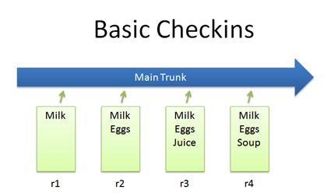
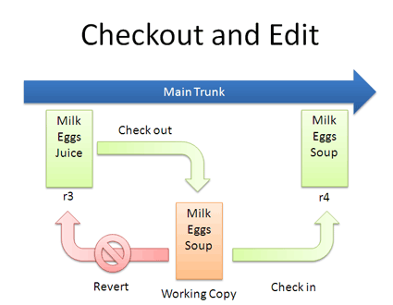
Check-In & Check-Out

Slide 8
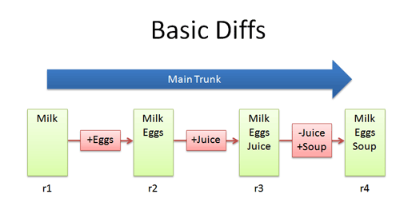
Diffs

Slide 9
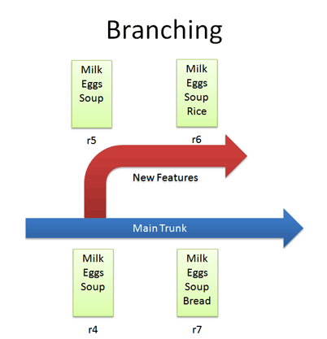
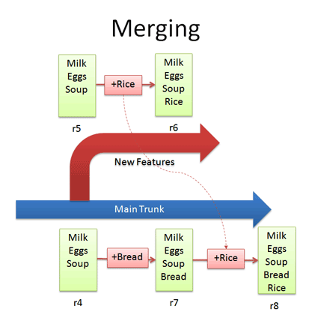
Branching & Merging

Slide 10
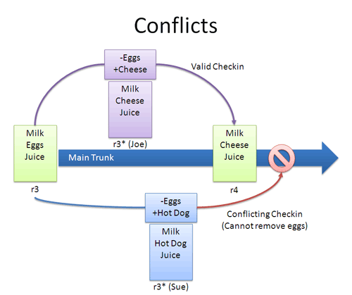
Conflicts

Slide 11
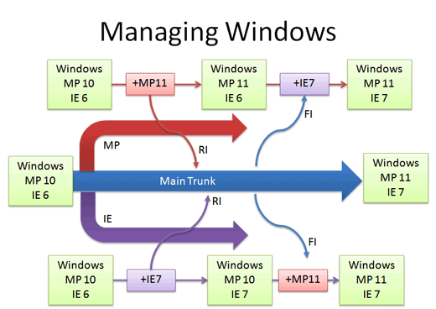
Real Life Example

Slide 12
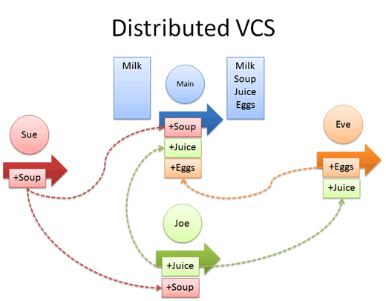
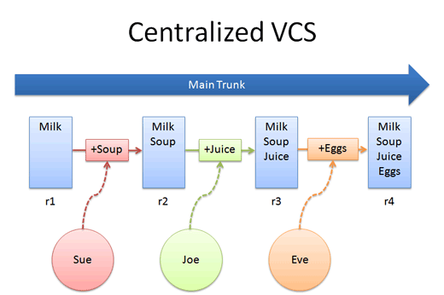
Centralized vs. Distributed Version Control

Slide 13
Core Concepts
Centralized version control focuses on synchronizing, tracking, and backing up files.
Distributed version control focuses on sharing changes; every change has a guid or unique id.
Recording/Downloading and applying a change are separate steps (in a centralized system, they happen together).
Distributed systems have no forced structure. You can create “centrally administered” locations or keep everyone as peers.
push: send a change to another repository (may require permission)
pull: grab a change from a repository
Notes:
New terminology: push and pull

Slide 14
Key Advantages
Everyone has a local sandbox. You can make changes and roll back, all on your local machine. No more giant check-ins; your incremental history is in your repo.
It works offline. You only need to be online to share changes. Otherwise, you can happily stay on your local machine, checking in and undoing, no matter if the “server” is down or you’re on an airplane.
It’s fast. Diffs, commits and reverts are all done locally. There’s no shaky network or server to ask for old revisions from a year ago.
It handles changes well. Distributed version control systems were built around sharing changes. Every change has a guid which makes it easy to track.
Branching and merging is easy. Because every developer “has their own branch”, every shared change is like reverse integration. But the guids make it easy to automatically combine changes and avoid duplicates.
Less management. Distributed VCSes are easy to get running; there’s no “always-running” server software to install.
Notes:
New terminology: push and pull

Slide 15
Key Disadvantages
You still need a backup. Some claim your “backup” is the other machines that have your changes. I don’t buy it — what if they didn’t accept them all? What if they’re offline and you have new changes? With a DVCS, you still want a machine to push changes to “just in case”. (In Subversion, you usually dedicate a machine to store the main repo; do the same for a DVCS).
There’s not really a “latest version”. If there’s no central location, you don’t immediately know whether to see Sue, Joe or Eve for the latest version. Again, a central location helps clarify what the latest “stable” release is.
There aren’t really revision numbers. Every repo has its own revision numbers depending on the changes. Instead, people refer to change numbers: Pardon me, do you have change fa33e7b? (Remember, the id is an ugly guid). Thankfully, you can tag releases with meaningful names.

Slide 16
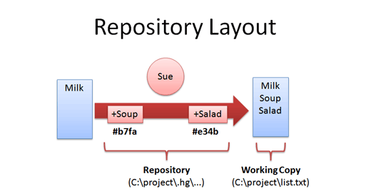
Distributed Repo Layout
Notes:
You have:
A working copy. The files you are currently editing.
A repository. A directory (.hg in Mercurial) containing all patches and metadata (comments, guids, dates, etc.). There’s no central server so the data stays with you.
In our distributed example, Sue, Joe and Eve have their own repos, with independent revision histories.

Slide 17
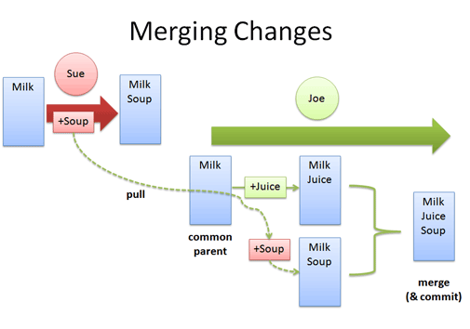
Updates and Merge

Slide 18
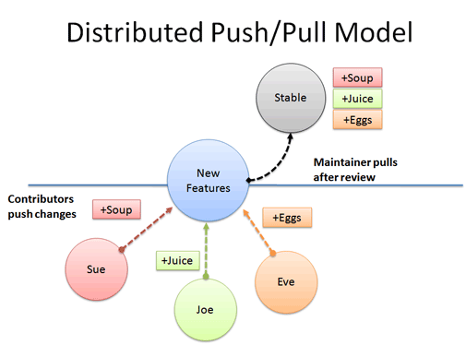
Organizing a distributed project

